Slide 1
STATUS REPORT: WEEK: 01
Md. Zillur Rahman • 02.11.2019
S. M. Foysal Ahmed • 02.11.2019

Slide 2
Overview
Expected delivery
December 26, 2019
Recent progress
Working Platforms Sign up
Environment Set Up
The First chunk of Code

Slide 3
Progress - Project Management & Communication Platform
Project Management
Trello Account
Slack Account
Code Management
Git (For VCS)
GItHub Account (For Hosting)

Slide 4
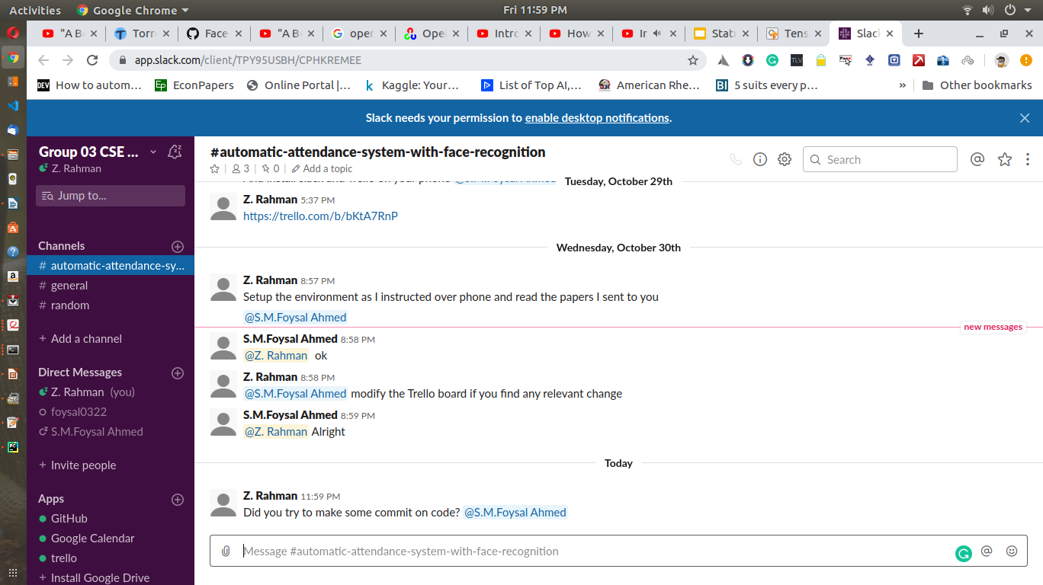

Slide 5
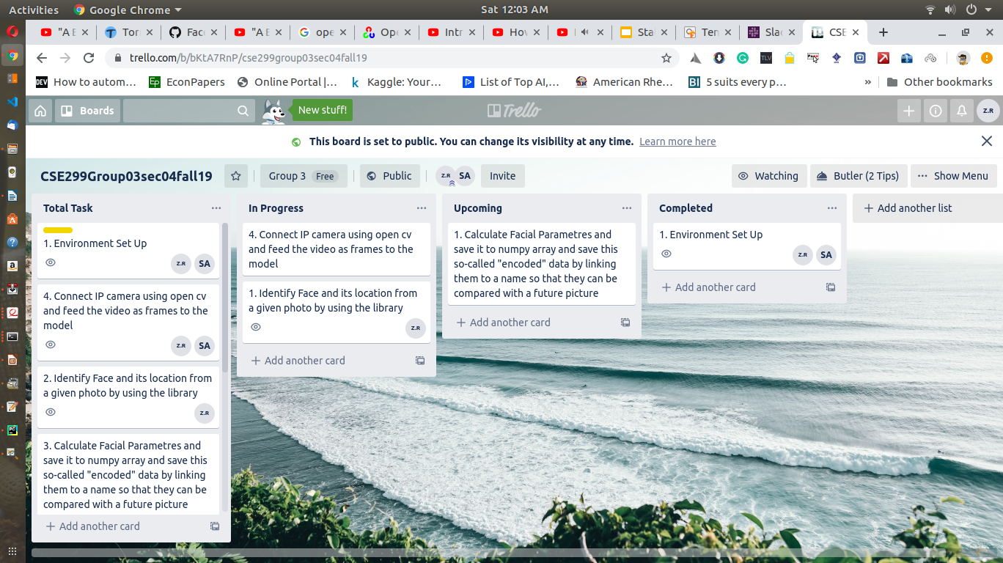

Slide 6
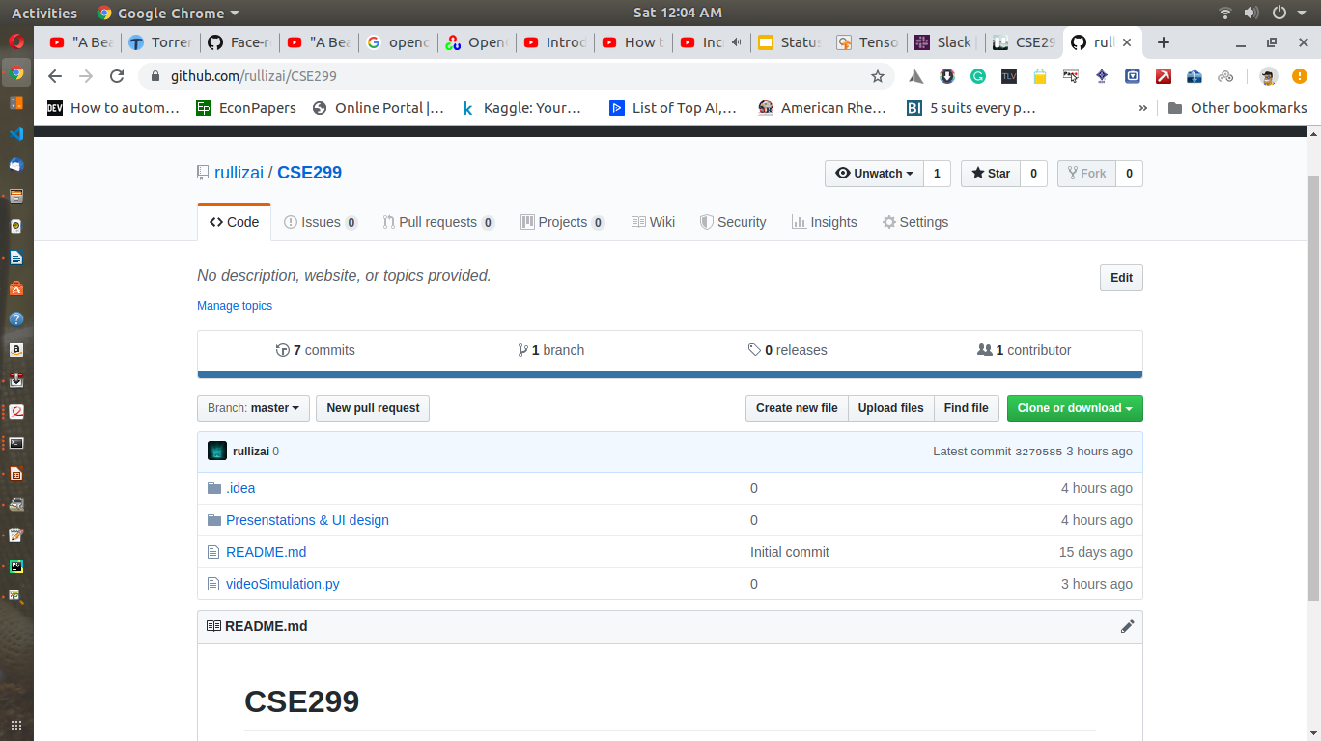

Slide 7
Progress - Developing Environment Set Up
Background Study
How face detection and recognition works
How to process video and image with OpenCV
The working environment set up (Anaconda, Pycharm, OpenCv)
The First Chunks of code
Live Streaming from webcam using OpenCv

Slide 8
Goals for next week
Feed the video as frames to the model
Identify Face and its location from a given photo by using the library

